Slide 1
Temple of the Lost
Team: Golden Ducks
Axure Prototype Presentation
Due: Wednesday, Nov 20, 2019
Group Members:
Hussy Hussein, Jordan Odu, Frankie Reitzel, Jordan Odu

Slide 2
Introduction
Not seeing what is to come
Setting is in the dark
Learning to use what you have wisely
Limited amount of light
Everything is not as it seems
Cupcakes are bad, ducks are good
All phenomenons have to do with exploring the unexpected

Slide 3
Playthrough

Slide 4

Mechanics
Rules of the game
Players must make a choice on which door
Ducks give light
Cupcakes take it away
You can run out of light and this will cause you to lose
Duck and light replenish
Every duck gives you more light
There are limited ducks
Even with ducks you must watch how much light you use
Dark panels
Allow for the feeling of unknown
Do not follow a pattern adding a challenge

Slide 5
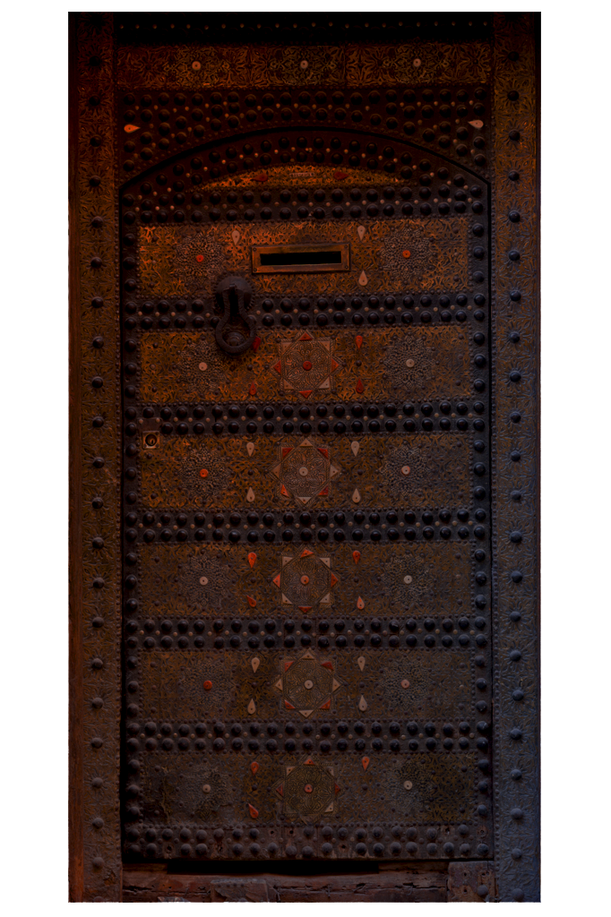
Dynamics
Skills learned throughout the game
Conserving light
Strategically picking areas
Good looking objects aren’t always good
One wrong move can end the game
What the player walks away from the game with
Using resources wisely
Becoming more aware of surroundings

Slide 6

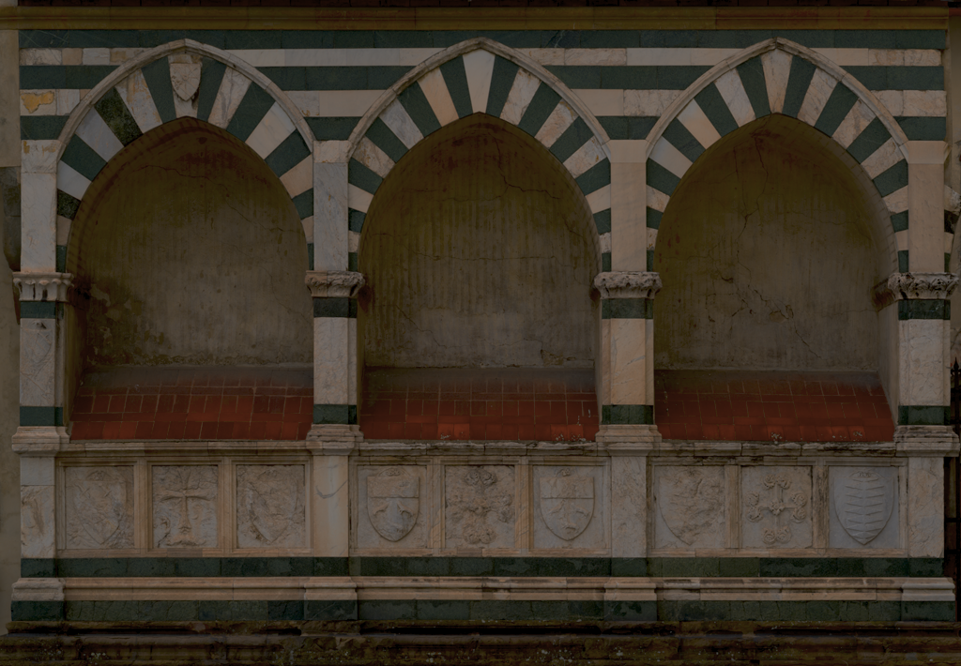
Aesthetics
Evokes a sense of perseverance
The narrative allows for a reason to continue
The reward of finding a duck
Confusion
The panels are random
The items are meant to trick the player
Responsability
Watching the resources
Keeping in mind the reason for the mission

Slide 7
Narratives

Slide 8
Data Model

Slide 9
Task Flow

Slide 10
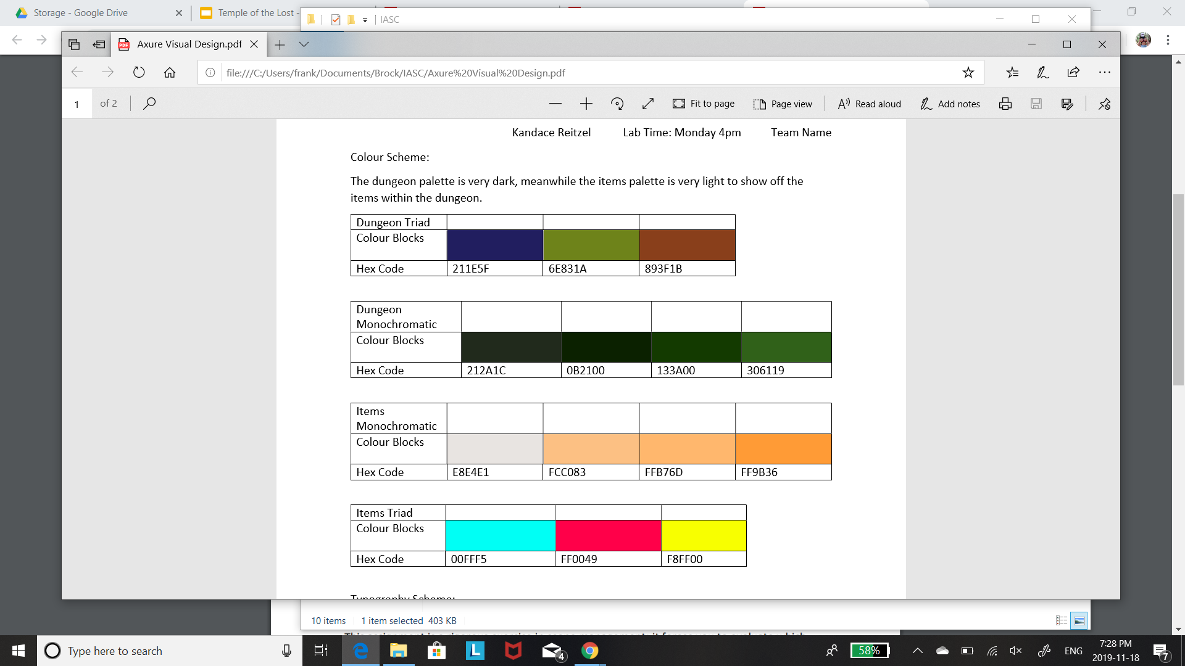
Style Guides
Light
Light was used for items
Made to contrast the dark background
Monochromatic allowed for more shade choices
Dark
Meant to give an eerie temple feeling
Much darker to contrast items
Gives the illusion of being in a dark room

Slide 11
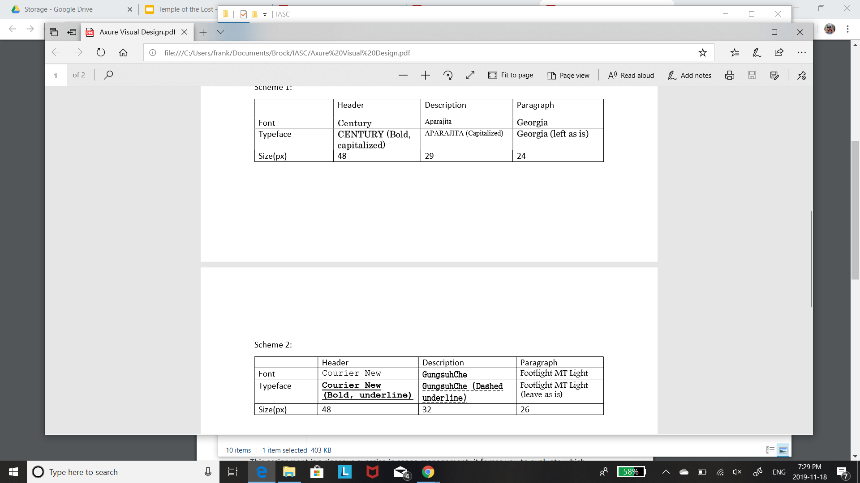
Style Guide
Fonts
Chosen to depict and old environment
Give an ancient feel to much of the game
Readable but still old looking
Some fonts were not available

Slide 12
Failures/Challenges
1.
2.

Slide 13
Improvements
More self-made graphics
Randomization
3D effects
More interaction options

